Slide 1
Find us online...
@rise.ne
Newcastle and Gateshead Mental Health Support Team (MHST)
@rise_mhst
bit.ly/Rise-ne
rise.childrenssociety
.org.uk/
Notes:
​

Slide 2
RISE Newcastle and Gateshead Mental Health School Support Team (MHST) is funded by the NHS and DfE and provides a ‘Whole School Approach’ for low intensity emotional wellbeing and mental health needs.
We support Schools, Colleges and Elective Home Educated Children and Young People, parents/carers and professionals and we also take a referrals from Single Point of Access (SPA).

Slide 3
Our highly trained Education Mental Health Practitioners (EMHP) and Children’s Wellbeing Practitioners (CWP) work alongside education professionals (generally Mental Health Leads/SENCOs) & parents/carers to offer low intensity mental health support for children and young people from primary school age through to further education (5-18 year olds).

Slide 4
The ‘whole school approach’ includes:
School Resource Booklet and Referral Guide
One to one work
Small groups
Parent-led CBT
Class workshops
Assemblies
Training offer
Drop-in sessions
Digital Offer - Information for parents/ carers of good quality Apps and resources that are age appropriate and clinically sound. Wellbeing resources via our website, social media pages and YouTube channel
Referrals for online support through our partner, Healios
Essential wellbeing evidence for OFSTED reporting

Slide 5
RISE offer a range of therapeutic approaches to encourage children and young people to feel able to manage how they are feeling and have the ability to talk through things that are on their mind
These might include:
• Education on managing anxiety/ worries
• Low mood - sadness
• Exploring emotions/ emotional regulation
• Self esteem
• Resilience
• Friendships
• Advice on sleep hygiene, problem solving and panic attacks
• Exam stress
• School transitions
• Signposting to other appropriate services/support

Slide 6
What does our delivery look like?
EMHP’s are assigned to an educational setting for one day per week, across a full term (12 weeks)
Direct delivery will be across an 8-week block, with two weeks either side for preparation and catch up.
Each of our EMHP’s will be able to deliver up to 4 sessions per day. One of these sessions can be a 1:1 session and we recommend that 6 sessions are delivered per child.
The other 3 sessions can be made up of small group work (up to a maximum of 6 children in each group) and whole class sessions.
Schools refer CYP for 1:1/Small Group support with parental consent
Assemblies and staff development are then woven in throughout delivery
Free online resources are provided – Self-Help Guides

Slide 7
SEND and Non-mainstream provision
We have worked with many CYP with Special Education Needs and Disabilities (SEND) in mainstream education and continue to do so.
SEMH (Social, Emotion & Mental Health) is categorised as a Special Educational Need.
Moving forwards we are hoping to establish a programme that can be adapted for differing needs and offers increased accessibility. However, we also want to ensure our programme is ethically robust.
E.g.– we may need to consider our delivery window.

Slide 8
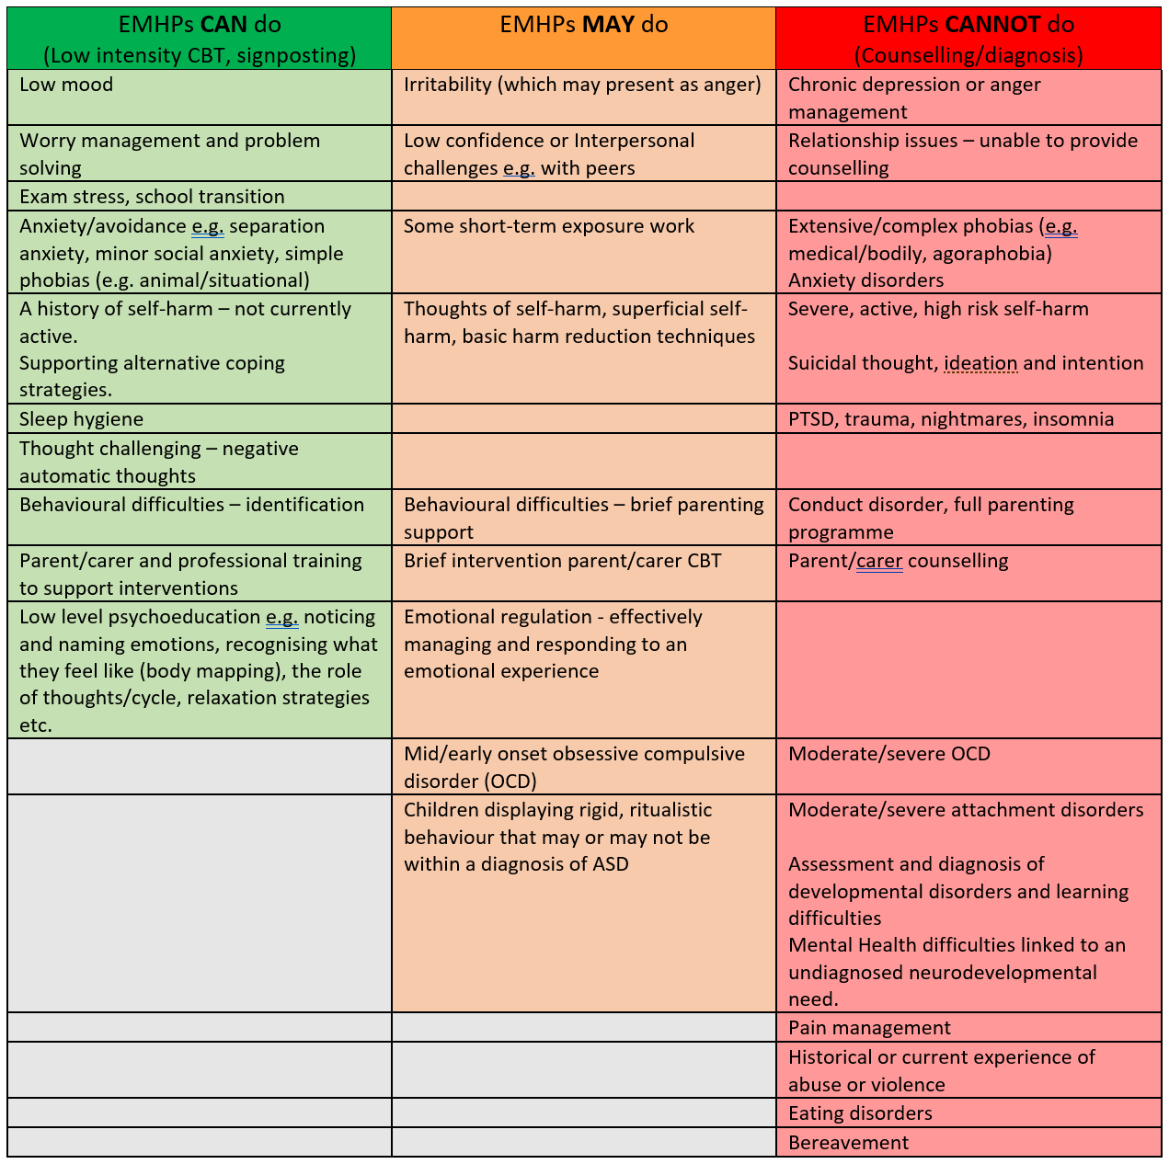
Referrals:
RISE only takes referrals directly from the schools we are based in each term and from CYPS SPA.
We provide a comprehensive referral guide to support this process.
Unfortunately we do not accept referrals from parents/professionals outside of these parameters.

Slide 9
Emerging Themes:
In Newcastle, our most common presenting issues are always anxiety and emotional regulation.
More recently there has been a significant increase in CYP who are suffering worries or anxiety in relation to domestic violence.
We have also seen an increase in the number of KS1 and KS2 CYP who lack basic social skills resulting in poor and inconsistent peer relationships and present with ‘separation anxiety’ like behaviours, following the COVID-19 pandemic
Furthermore, a large proportion of our CYP seek support from RISE as a first line intervention prior to being considered for a neurodiversity assessment due to presenting with typically neuro-diverse behaviours.

Slide 10
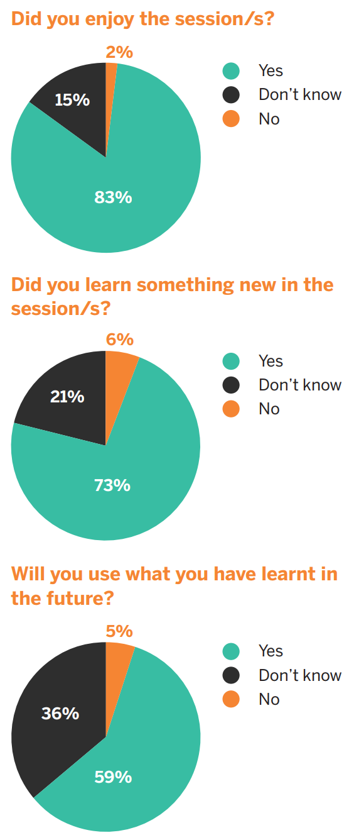
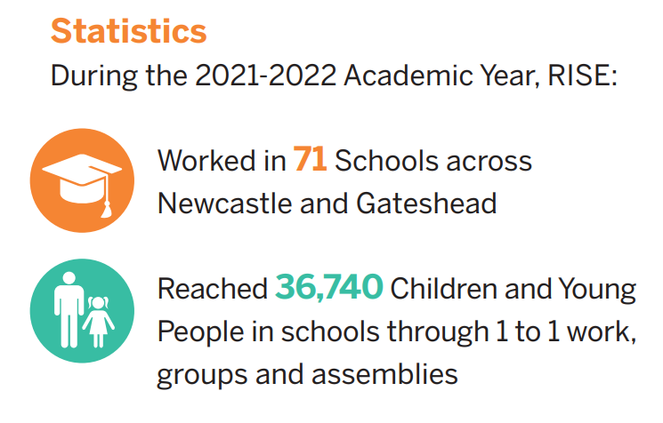
Impact:

Slide 11
Newcastle School Partnerships (so far…)
Primary –
Archibald First School
Regent Farm First School
South Gosforth First School
Beech Hill Primary
Cheviot Primary
Cragside Primary
Farne Primary
Hilton Primary
Kenton Bar Primary
Kingston Park Primary
Lemington Riverside Primary
Moorside Primary
Mountfield Primary
Newburn Manor Primary
North Fawdon Primary
Sacred Heart RC Primary
Milecastle Primary
Knoplaw Primary
St Alban’s Catholic Primary
St Catherine’s Catholic Primary
St Cuthbert’s (Kenton)
St Cuthbert’s (Walbottle)
Stocksfield Avenue Primary
Throckley Primary
Walbottle Village Primary
Walkergate Community School
Waverley Primary
West Denton Primary
Westerhope Primary
Wyndham Primary
Brunton First School
West Gate Hill Primary
Canning Street Primary
Speciality/Alternative Provision –
Newcastle Bridges School
Mary Astell Academy
Middle/Secondary -
Excelsior Academy
Benfield School
Gosforth High Academy
Jesmond Park Academy
Kenton School
Sacred Heart Catholic High School
Walbottle Academy
Walker Riverside Academy
Gosforth East Middle
College –
Newcastle College

Slide 12
School Wellbeing Survey (middle/secondary)
School-based survey is to hear from children about their lives
The survey will help inform the schools approach to wellbeing.
Consists of an online questionnaire which CYP complete themselves.
Takes about 20 minutes to complete
Based on The Children’s Society’s Good Childhood research programme (this allows for national benchmarks)
All survey responses are confidential and anonymous
No information will be published which could identify individual schools or children that have taken part.
After the survey has been completed in your school, the team at The Children’s Society will analyse the data and produce a summary of the findings for school staff.
Staff from The Children’s Society will facilitate a feedback session to identify issues and opportunities to improve wellbeing based on the insights from the data. This may include suggesting whole school strategies and where appropriate additional support offers.

Slide 13
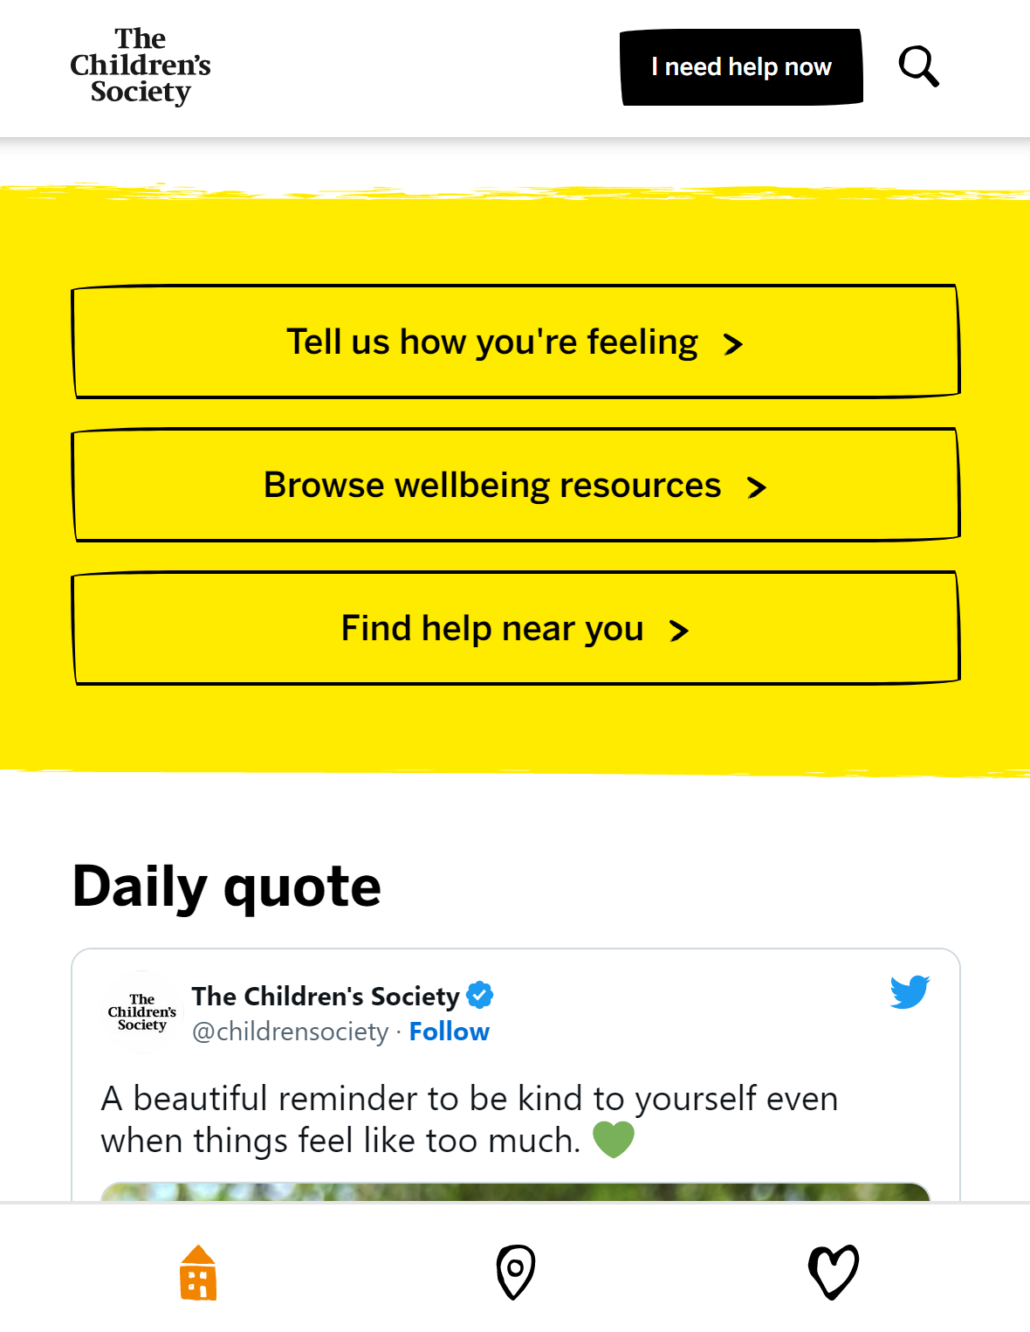
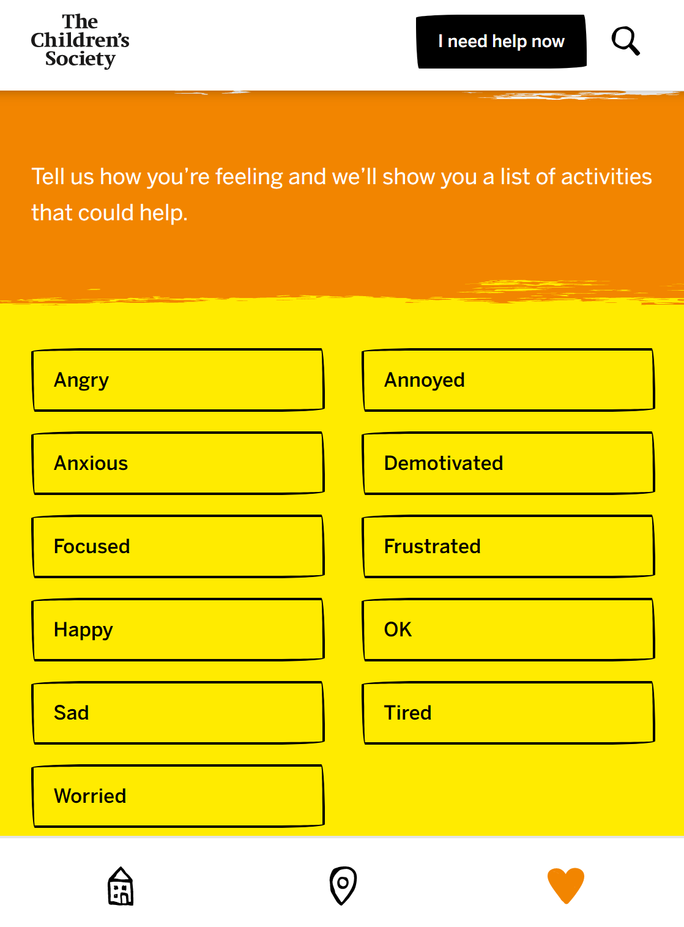
Wellbeing app: 15-18 year olds

Slide 14
Parent feedback:
“Whatever you’re doing keep doing it! She is telling me how she feels now and she’s never done that before”
Thank you!
Do you have any questions?

