Slide 1
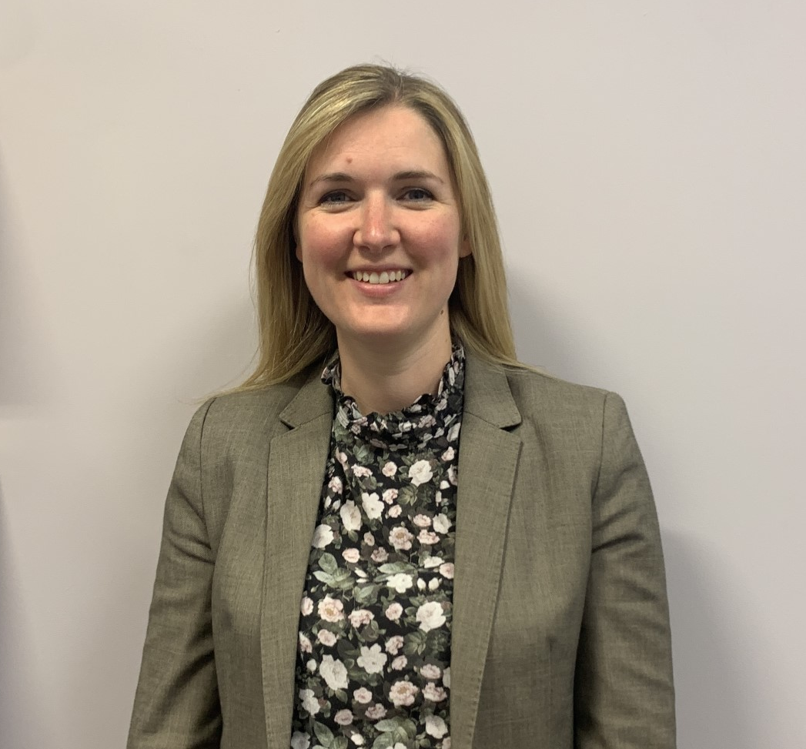
SEMH Outreach (Primary)
Sarah Northey – SEN Consultant Teacher
Trinity Academy Newcastle
First Steps
Review paperwork
Observe young person
Meet with key staff
Range of Advice/Support
Observations and recommended strategies Behaviour leadership Behavioural Support Plans SEMH interventions Circle of adults Coaching with key staff | Reviews to monitor impact Signposting resources and intervention Risk Assessment Trauma informed approaches Sensory Integration advice Bespoke to each setting and need

